Slide 1
ClinicalPath: a Visualization Tool to Improve the Evaluation of Electronic Health Records in Clinical Decision-Making
IEEE Transactions on Visualization & Computer Graphics (TVCG-22)
Claudio D. G. Linhares, Daniel M. Lima, Jean R. Ponciano, Mauro M. Olivatto, Marco A. Gutierrez,
Jorge Poco, Caetano Traina Jr., and Agma J. M. Traina
Group 10:
413540003 Dao Cong Tinh 桃公信, 413540004 Phan Nguyen Minh Thao 潘阮明草, 313540015 Le Minh Bang 黎明朋

Slide 2

Outline
Introduction
Related Work
ClinicalPath
Case Study
User Validation
Conclusion

Slide 3

01.
Introduction

Slide 4


Introduction - Physician’ daily procedure
Tight, challenging schedules
High-stakes, quick decisions
Disorientation in long-term cases
Decision-making
support tools
COVID limits interpretation tim

Slide 5


Introduction - Electrical Health Record Systems
Store patient history
Reduces analysis time
Available developed areas [3]
Enhances perception [1]
Lack of individual analysis
Prediction and monitoring [2]
Visualization
A. Rind, T. D. Wang, W. Aigner, S. Miksch, K. Wongsuphasawat, C. Plaisant, and B. Shneiderman. Interactive information visualization to explore and query electronic health records. Found. Trends Hum.-Comput. Interact., 5(3):207–298, Feb. 2013. doi: 10.1561/1100000039
N. Rostamzadeh, S. Abdullah, and K. Sedig. Data-driven activities involving electronic health records: An activity and task analysis framework for interactive visualization tools. Multimodal Technologies and Interaction, 4:7, 03 2020. doi: 10.3390/mti4010007
C. Barriviera, Rodolfo abd Maziero and C. Trelha. Analysis of medical records management in Brazilian basic healthcare units: A qualitative approach. In HEALTHINFO 2017, pp. 46–51, 2017.

Slide 6

02.
Related Work

Slide 7
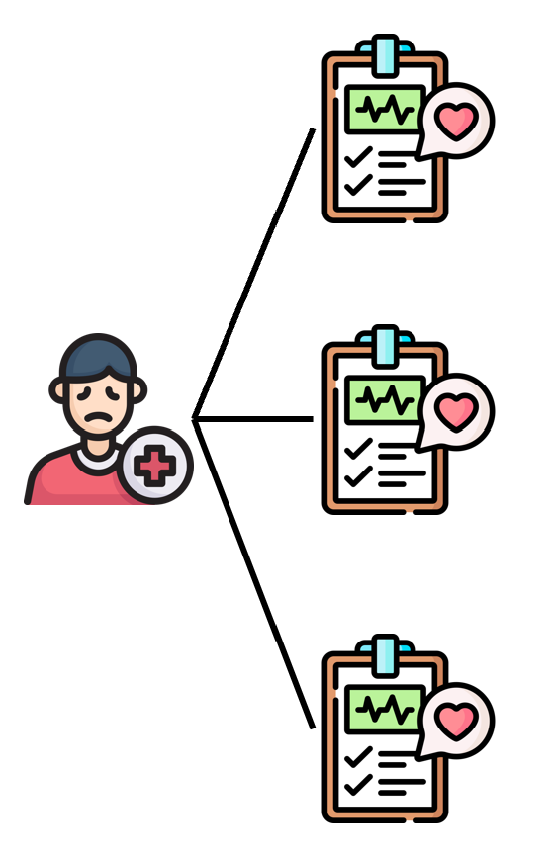
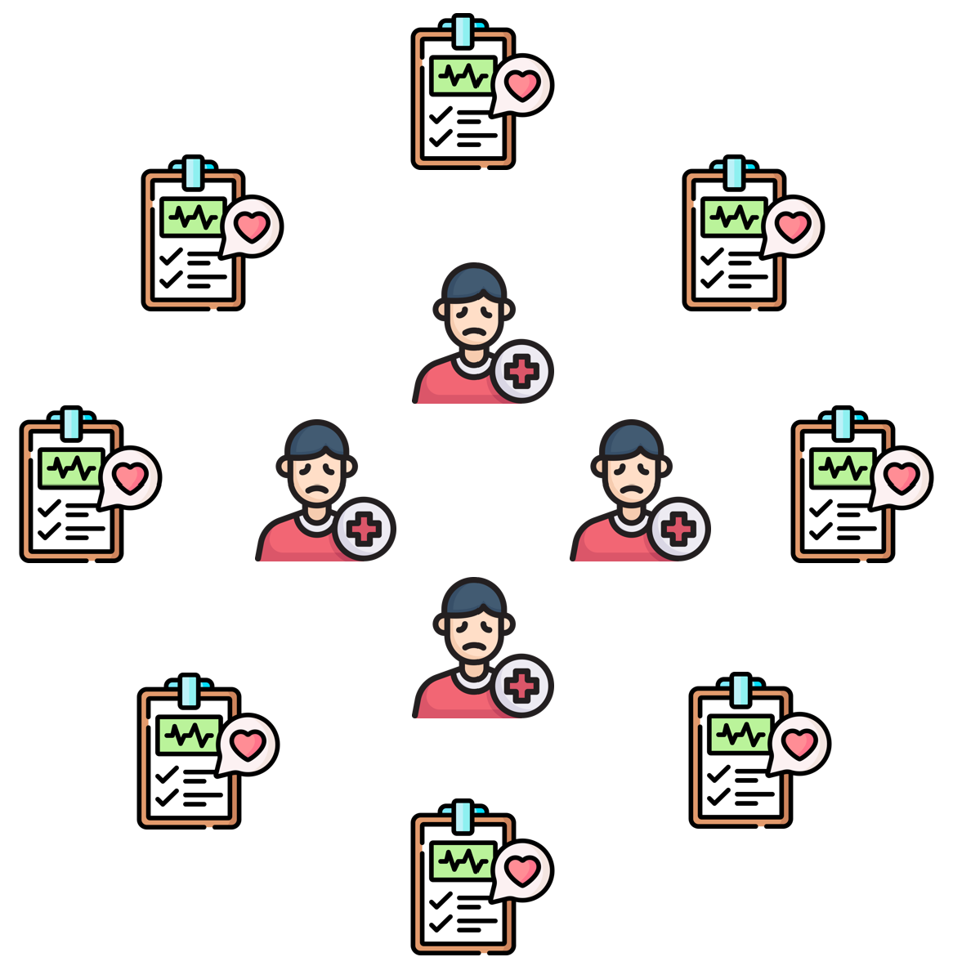
Related Work - EHR Systems
Population-based tools: Simultaneously visualized patient records
  LifeLines2 [Wang et al. 2009]
  VISITORS [Klimov et al. 2010]
Single-patient tools:
Local behaviors of visualizing a patient record
  CareVis [Algner et al. 2005]
  MIVA [Faiola et al. 2011]
  VisuExplore [Rind et al. 2011]
  HARVEST [Hisrsch et al. 2015]
  [Dabek et al. 2017]

Slide 8
Related Work - EHR Systems
Population-based tools: Simultaneously visualized patient records
Single-patient tools:
Local behaviors of visualizing a patient record
NOT meant for individual diagnostic hypotheses or patients’ clinical analyses
Visual Scalability
Interaction steps
Evaluation with specialist

Slide 9
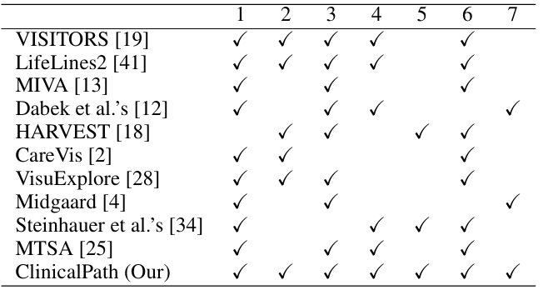
Related Work - EHR Systems
Comparison of EHR systems according to seven different aspects:
Selecting
Grouping
Filtering
Test result classification
Clinical history and outcome
User evaluation
Scalability of tests over time
A. Rind, T. D. Wang, W. Aigner, S. Miksch, K. Wongsuphasawat, C. Plaisant, and B. Shneiderman. Interactive information visualization to explore and query electronic health records. Found. Trends Hum.-Comput. Interact., 5(3):207–298, Feb. 2013. doi: 10.1561/1100000039
N. Rostamzadeh, S. Abdullah, and K. Sedig. Data-driven activities involv ing electronic health records: An activity and task analysis framework for interactive visualization tools. Multimodal Technologies and Interaction, 4:7, 03 2020. doi: 10.3390/mti4010007

Slide 10

03.
ClinicalPath

Slide 11

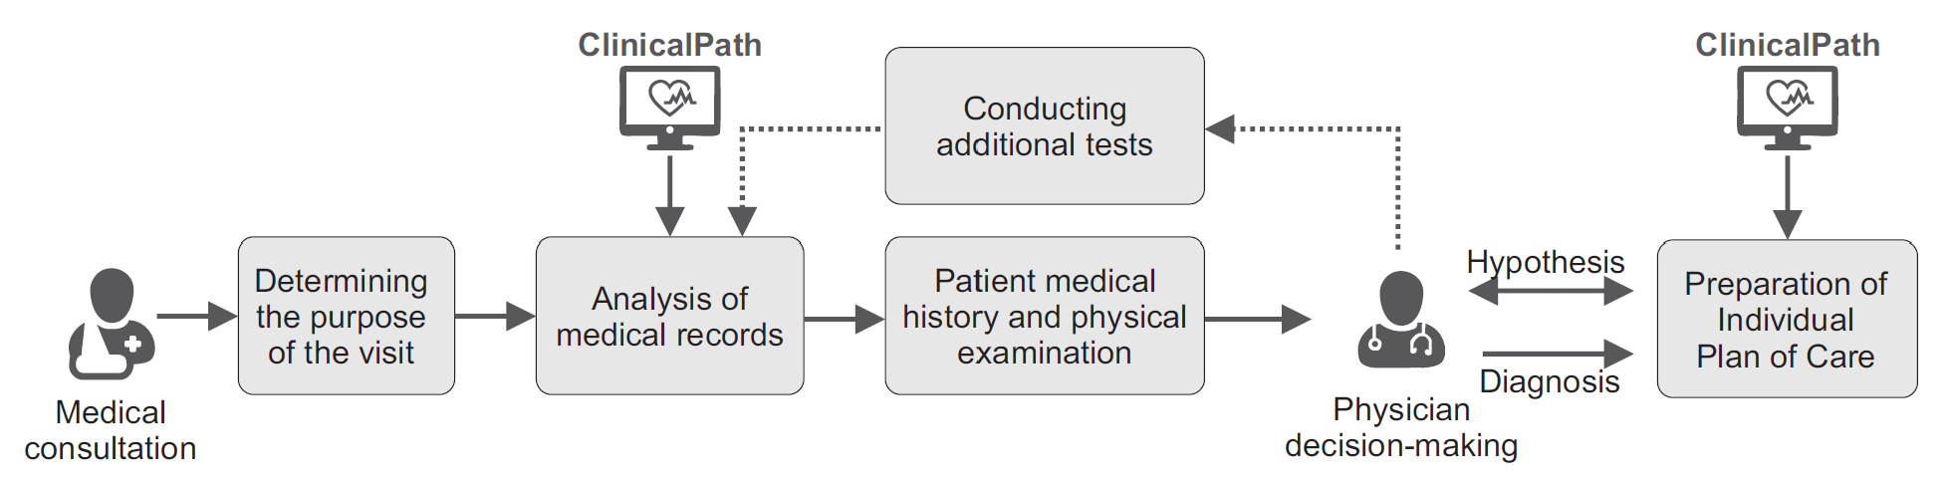
ClinicalPath - Clinical Workflow
Analyze the test results to indicate appropriate doses of medications or recommended procedures
Ex: collect key patient data
Ex: Family history of diseases (e.g., genetic diseases), medications of continuous use, history of previous surgeries, history of hospitalizations, allergies, and others
General description of the clinical workflow of a physician in a regular medical consultation, and the importance of the ClinicalPath system to help the physician in the decision-making process.
Assist in choosing doses of medications or procedures

Slide 12
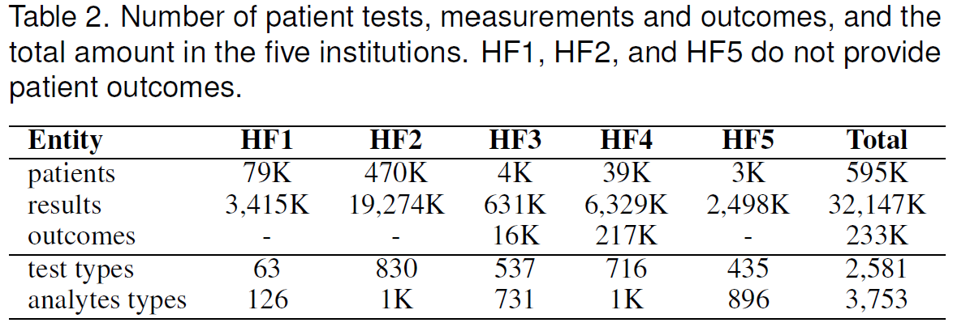
ClinicalPath - Dataset
FAPESP COVID-19 Data Sharing/BR Repository [1]
HF1: Albert Einstein Hospital, HF2: Fleury laboratories, HF3: Sírio-Libanês Hospital, HF4: Beneficência Portuguesa/SP Hospital, HF5: Hospital das Clinicas
FAPESP. FAPESP COVID-19 Data Sharing/BR, 2021.

Slide 13
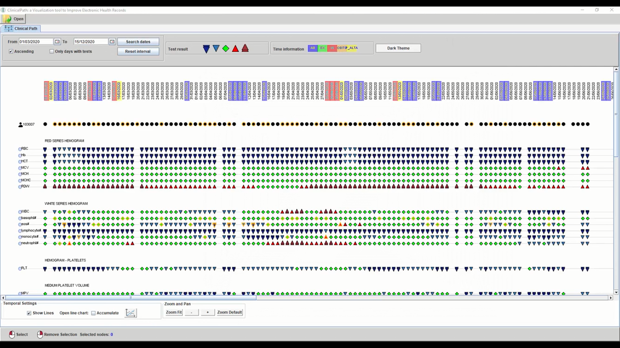
ClinicalPath - Overview

Slide 14
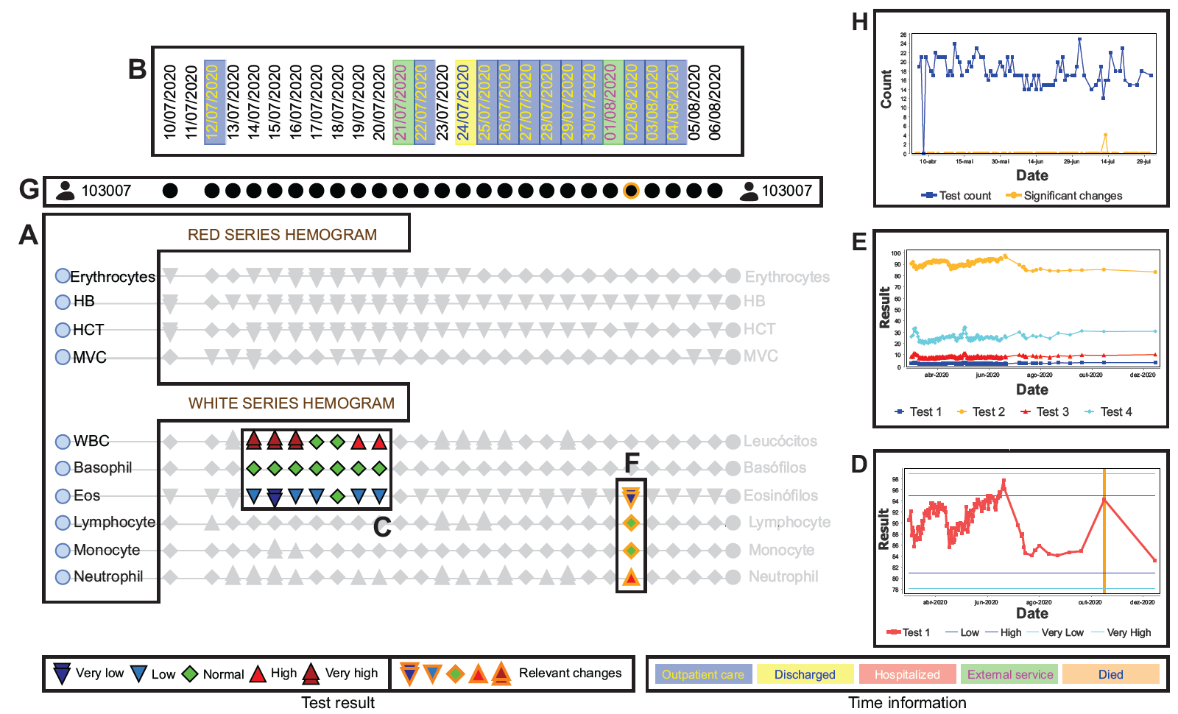
ClinicalPath - Visual Design
Categorization of the tests
Timestamp information with color coding—note that the dates follow the Brazilian date format (dd/MM/yyyy)
Color and shape coding (symbols) for the test results
Line chart with the test result variation over time
Line chart combining different test results over time
Automatic highlighting relevant changes in tests results over time
Patient global and local information over time
Line chart showing patient information over time
Example of the Clinical path visualization divided into the main features

Slide 15
ClinicalPath - Visual Design (A)
Categorization of the tests
Timestamp information with color coding—note that the dates follow the Brazilian date format (dd/MM/yyyy)
Color and shape coding (symbols) for the test results
Line chart with the test result variation over time
Line chart combining different test results over time
Automatic highlighting relevant changes in tests results over time
Patient global and local information over time
Line chart showing patient information over time
Example of the Clinical path visualization divided into the main features

Slide 16
ClinicalPath - Visual Design (B)
Categorization of the tests
Timestamp information with color coding—note that the dates follow the Brazilian date format (dd/MM/yyyy)
Color and shape coding (symbols) for the test results
Line chart with the test result variation over time
Line chart combining different test results over time
Automatic highlighting relevant changes in tests results over time
Patient global and local information over time
Line chart showing patient information over time
Example of the Clinical path visualization divided into the main features

Slide 17
ClinicalPath - Visual Design (C)
Categorization of the tests
Timestamp information with color coding—note that the dates follow the Brazilian date format (dd/MM/yyyy)
Color and shape coding (symbols) for the test results
Line chart with the test result variation over time
Line chart combining different test results over time
Automatic highlighting relevant changes in tests results over time
Patient global and local information over time
Line chart showing patient information over time
Example of the Clinical path visualization divided into the main features

Slide 18
ClinicalPath - Visual Design (D)
Categorization of the tests
Timestamp information with color coding—note that the dates follow the Brazilian date format (dd/MM/yyyy)
Color and shape coding (symbols) for the test results
Line chart with the test result variation over time
Line chart combining different test results over time
Automatic highlighting relevant changes in tests results over time
Patient global and local information over time
Line chart showing patient information over time
Example of the Clinical path visualization divided into the main features

Slide 19
ClinicalPath - Visual Design (E)
Categorization of the tests
Timestamp information with color coding—note that the dates follow the Brazilian date format (dd/MM/yyyy)
Color and shape coding (symbols) for the test results
Line chart with the test result variation over time
Line chart combining different test results over time
Automatic highlighting relevant changes in tests results over time
Patient global and local information over time
Line chart showing patient information over time
Example of the Clinical path visualization divided into the main features

Slide 20
ClinicalPath - Visual Design (F)
Categorization of the tests
Timestamp information with color coding—note that the dates follow the Brazilian date format (dd/MM/yyyy)
Color and shape coding (symbols) for the test results
Line chart with the test result variation over time
Line chart combining different test results over time
Automatic highlighting relevant changes in tests results over time
Patient global and local information over time
Line chart showing patient information over time
Example of the Clinical path visualization divided into the main features

Slide 21
ClinicalPath - Visual Design (G)
Categorization of the tests
Timestamp information with color coding—note that the dates follow the Brazilian date format (dd/MM/yyyy)
Color and shape coding (symbols) for the test results
Line chart with the test result variation over time
Line chart combining different test results over time
Automatic highlighting relevant changes in tests results over time
Patient global and local information over time
Line chart showing patient information over time
Example of the Clinical path visualization divided into the main features

Slide 22
ClinicalPath - Visual Design (H)
Categorization of the tests
Timestamp information with color coding—note that the dates follow the Brazilian date format (dd/MM/yyyy)
Color and shape coding (symbols) for the test results
Line chart with the test result variation over time
Line chart combining different test results over time
Automatic highlighting relevant changes in tests results over time
Patient global and local information over time
Line chart showing patient information over time
Example of the Clinical path visualization divided into the main features

Slide 23
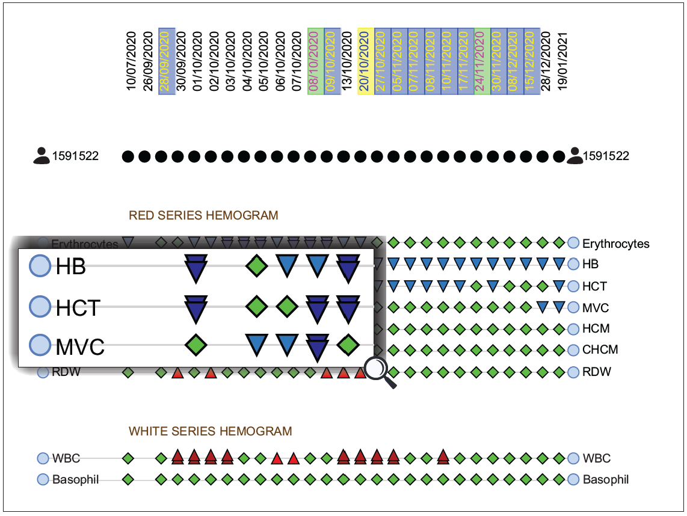
ClinicalPath - User Interaction
(a) Zoom and pan features

Slide 24
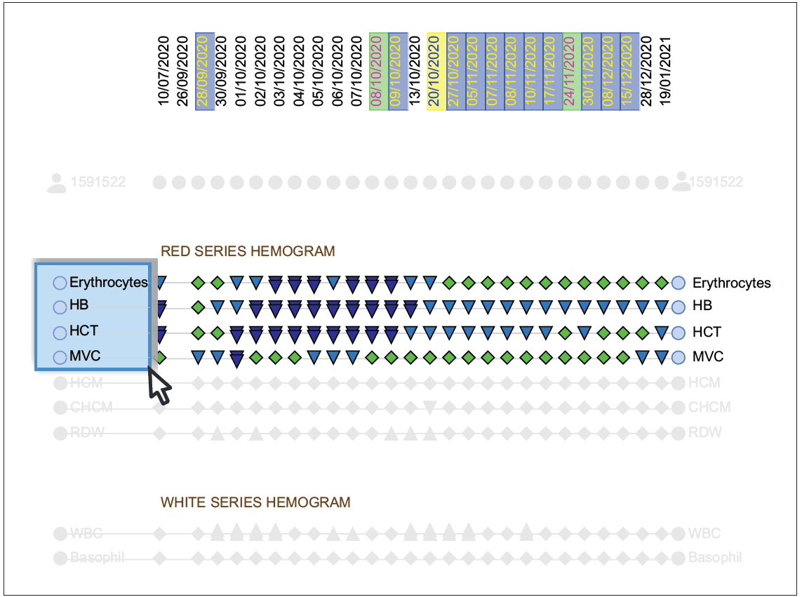
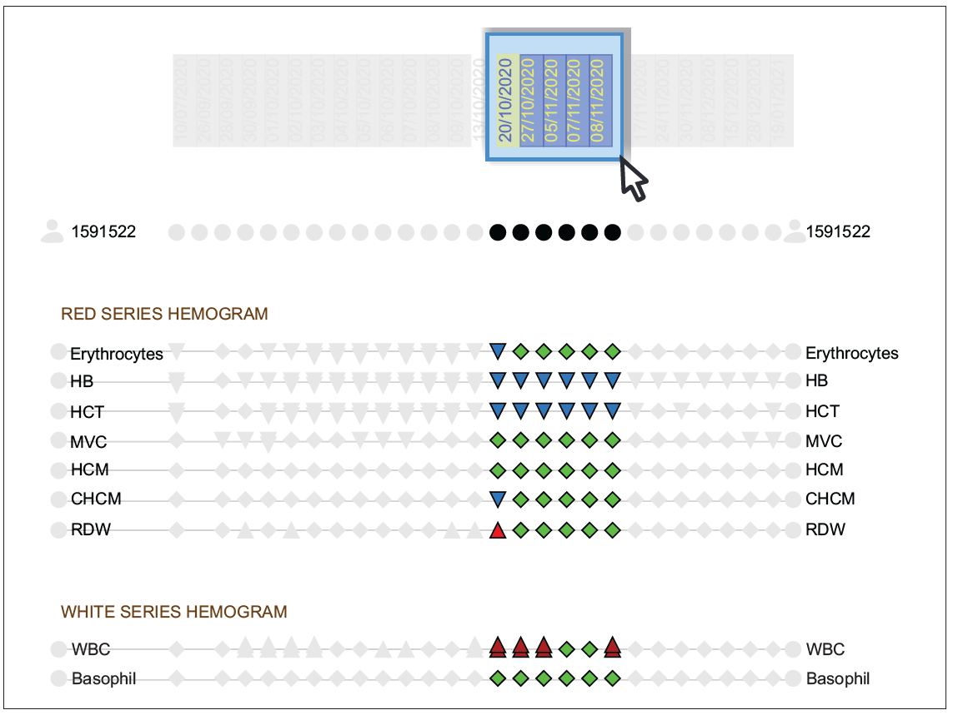
ClinicalPath - User Interaction
(b) Node selection
(c) Timestamp selection

Slide 25
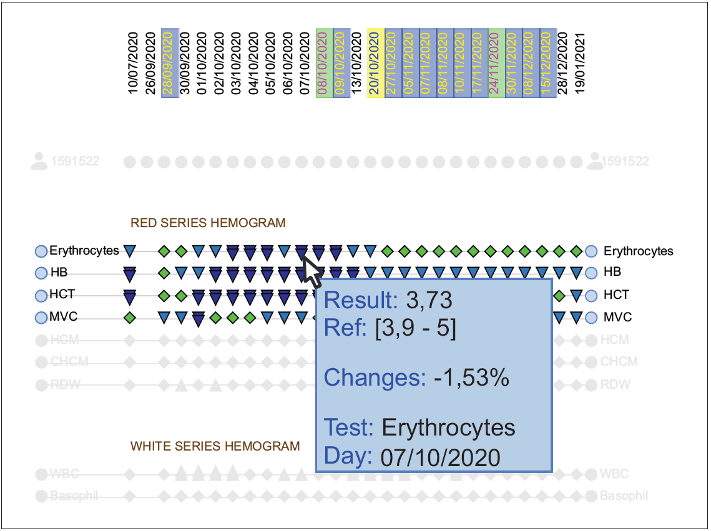
ClinicalPath - User Interaction
(d) Tooltip with complementary information (1)

Slide 26
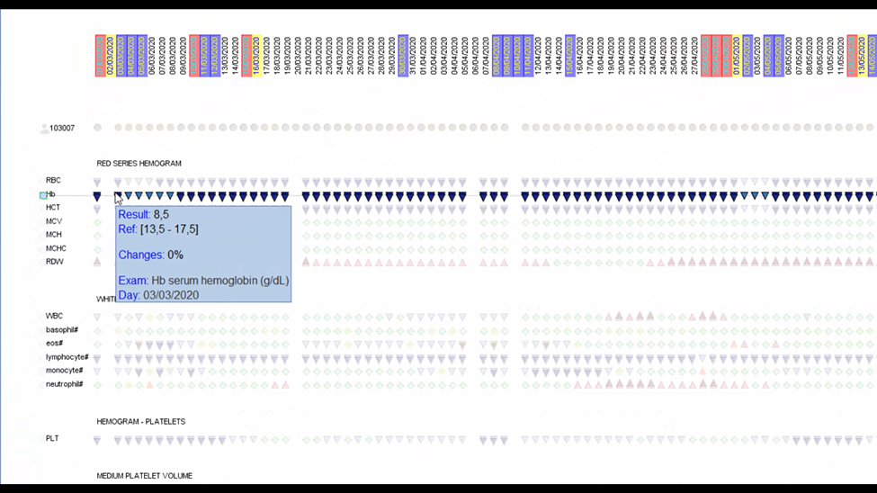
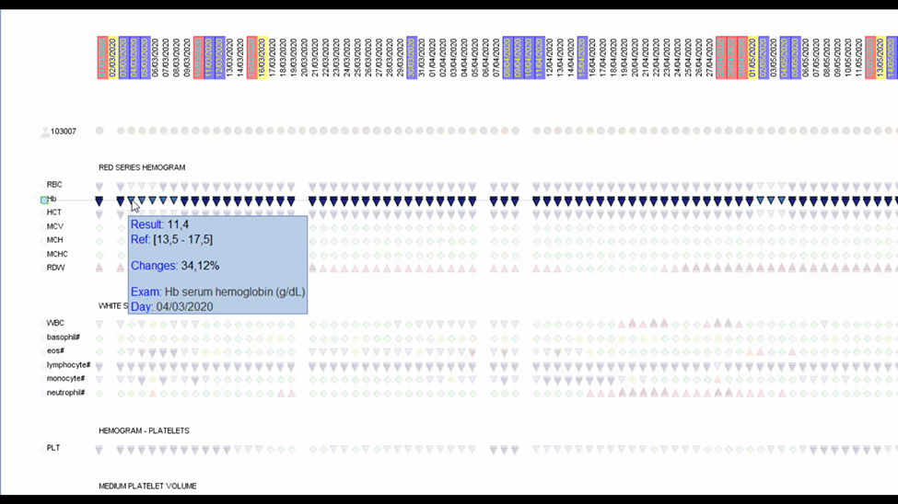
ClinicalPath - User Interaction
(d) Tooltip with complementary information (2)

Slide 27

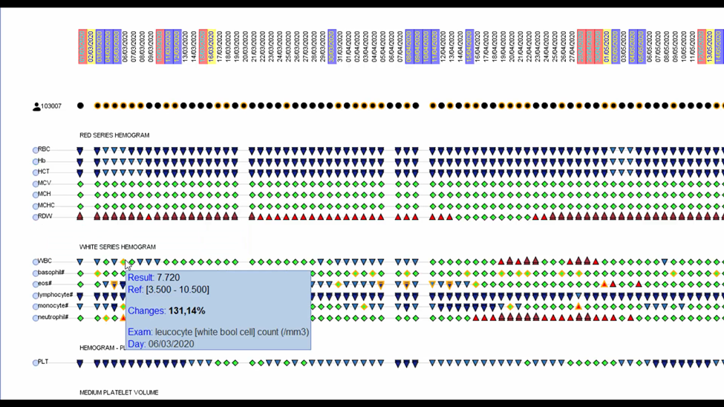
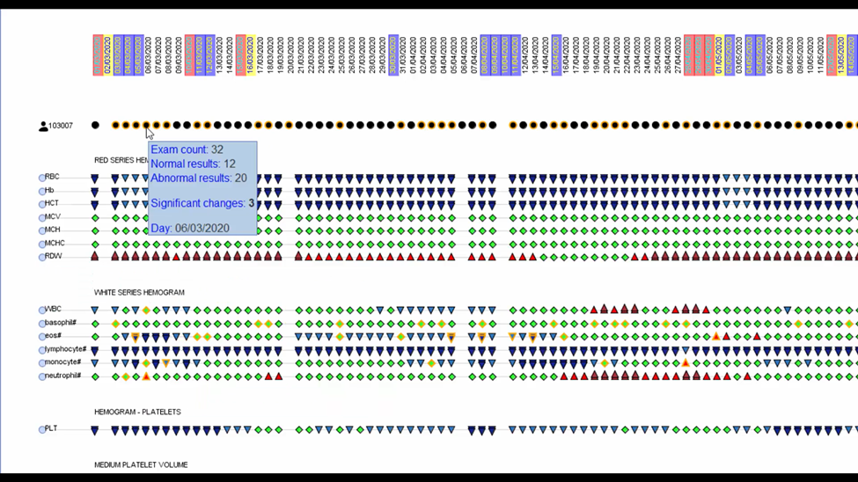
ClinicalPath - User Interaction
The RC (Rate of Change):
Vlt is the later value, and
Vet is the earlier value.
(d) Tooltip with complementary information (3)

Slide 28
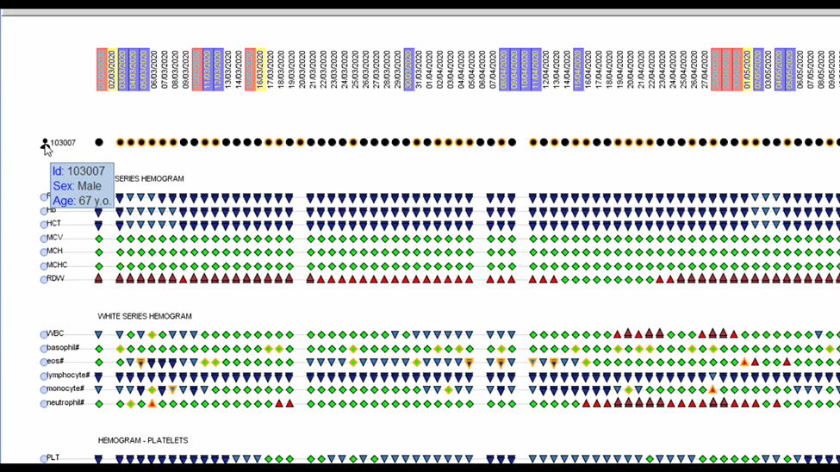
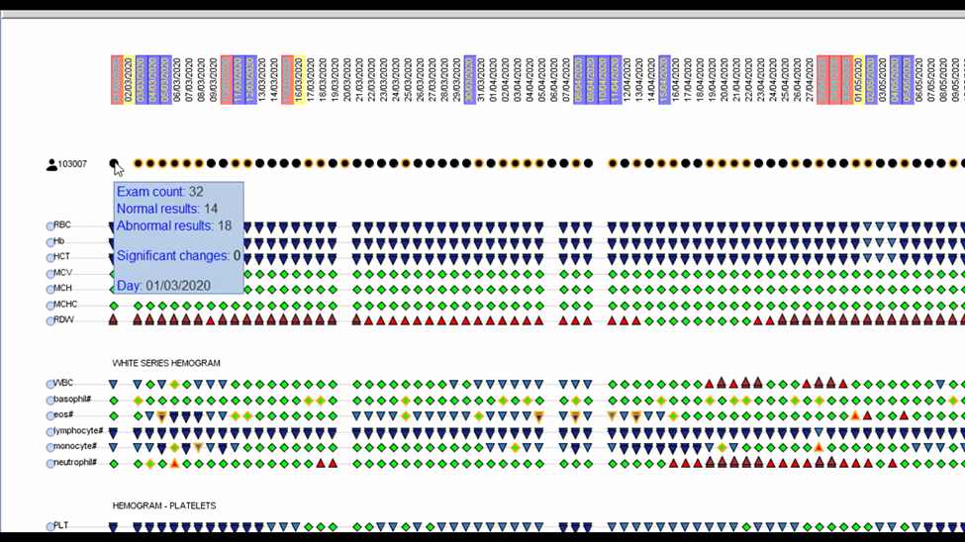
ClinicalPath - User Interaction
(d) Tooltip with complementary information (4)

Slide 29
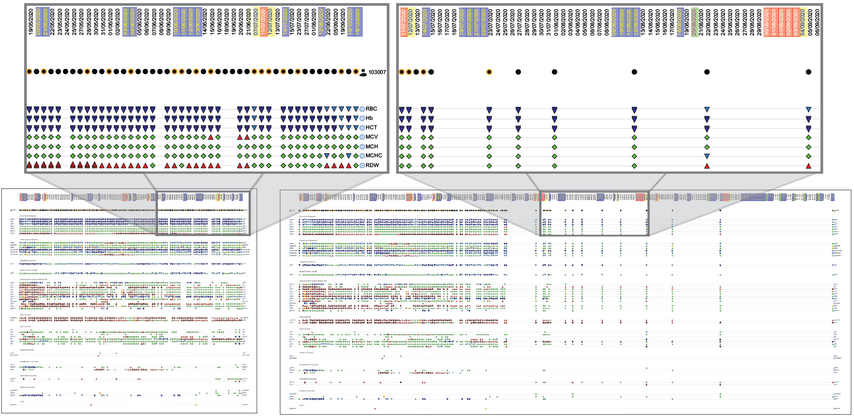
ClinicalPath - User Interaction
(a)
(b)
Impact of the filtering option “Only days with tests” in the screen space required for a patient with sporadic test results. Filtering enabled (a) and disabled (b). The highlighted areas show the blank space reduction.

Slide 30

04.
Case Study

Slide 31
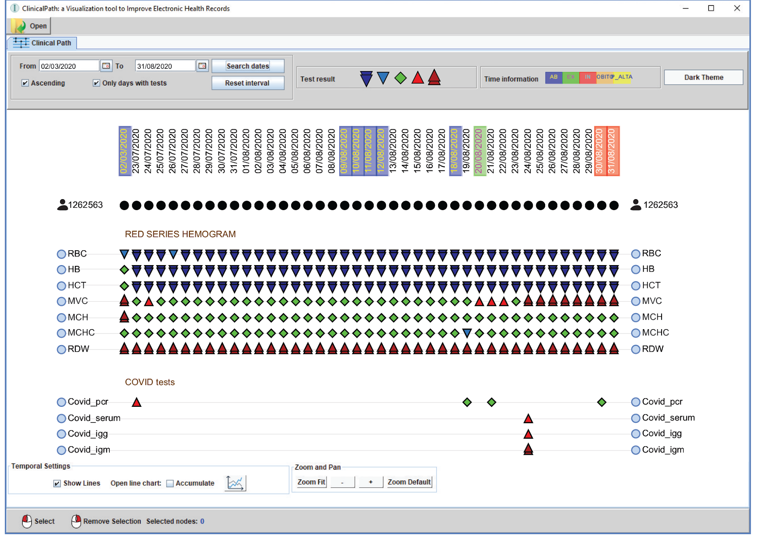
Case Study 1 - HB & COVID tests
ClinicalPath for other patient activity over time, with COVID and red series hemogram test information in the ClinicalPath system

Slide 32
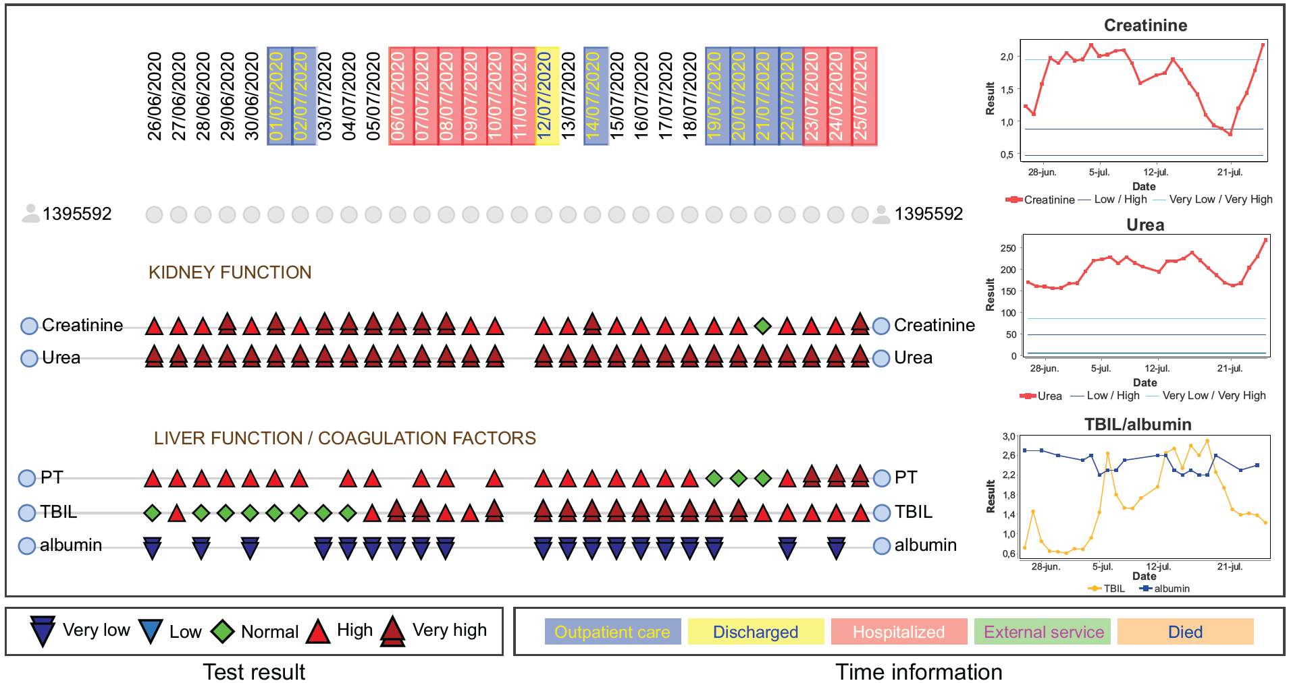
Case Study 2 - Kidney & Liver Tests
Visualization of patient activity over time, focused on kidney and liver function tests, using the proposed ClinicalPath system.

Slide 33

05.
User Validation

Slide 34
User Validation - Setting Experiment
Online and remotely evaluation.
Provides two videos:
  The tutorial installation system
  Instructions about the system’s basic functionalities

Slide 35
User Validation - Participants & Questionnaire
Participants
  15 medical graduates in Brazil.
  They had to interact with ClinicalPath system:
    66% men and 33% women
    60% of the participants are 24 years old or less
Questionnaire
  Background and experience
  3 questions that do not required medical knowledge
  5 questions that required medical knowledge

Slide 36
User Validation - Pilot Study
The need for the installation video
The participants consider about:
  The response time satisfactory
  The instructional video enough to understand the system’s usability

Slide 37
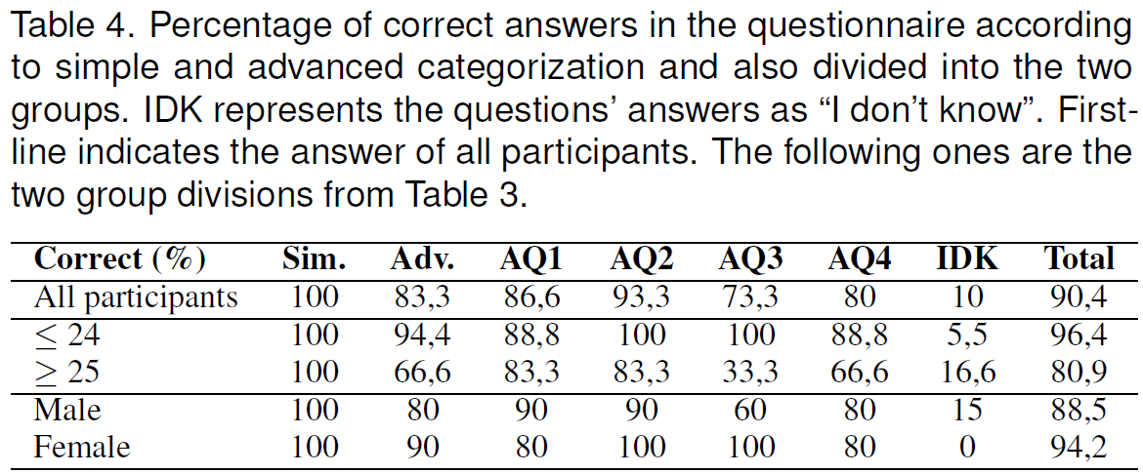
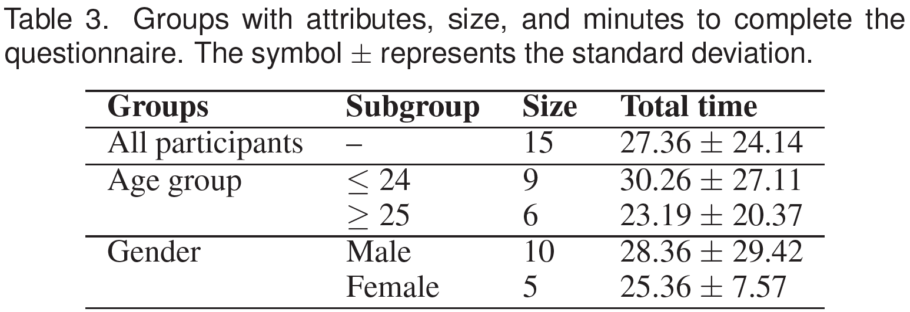
User Validation - Result

Slide 38
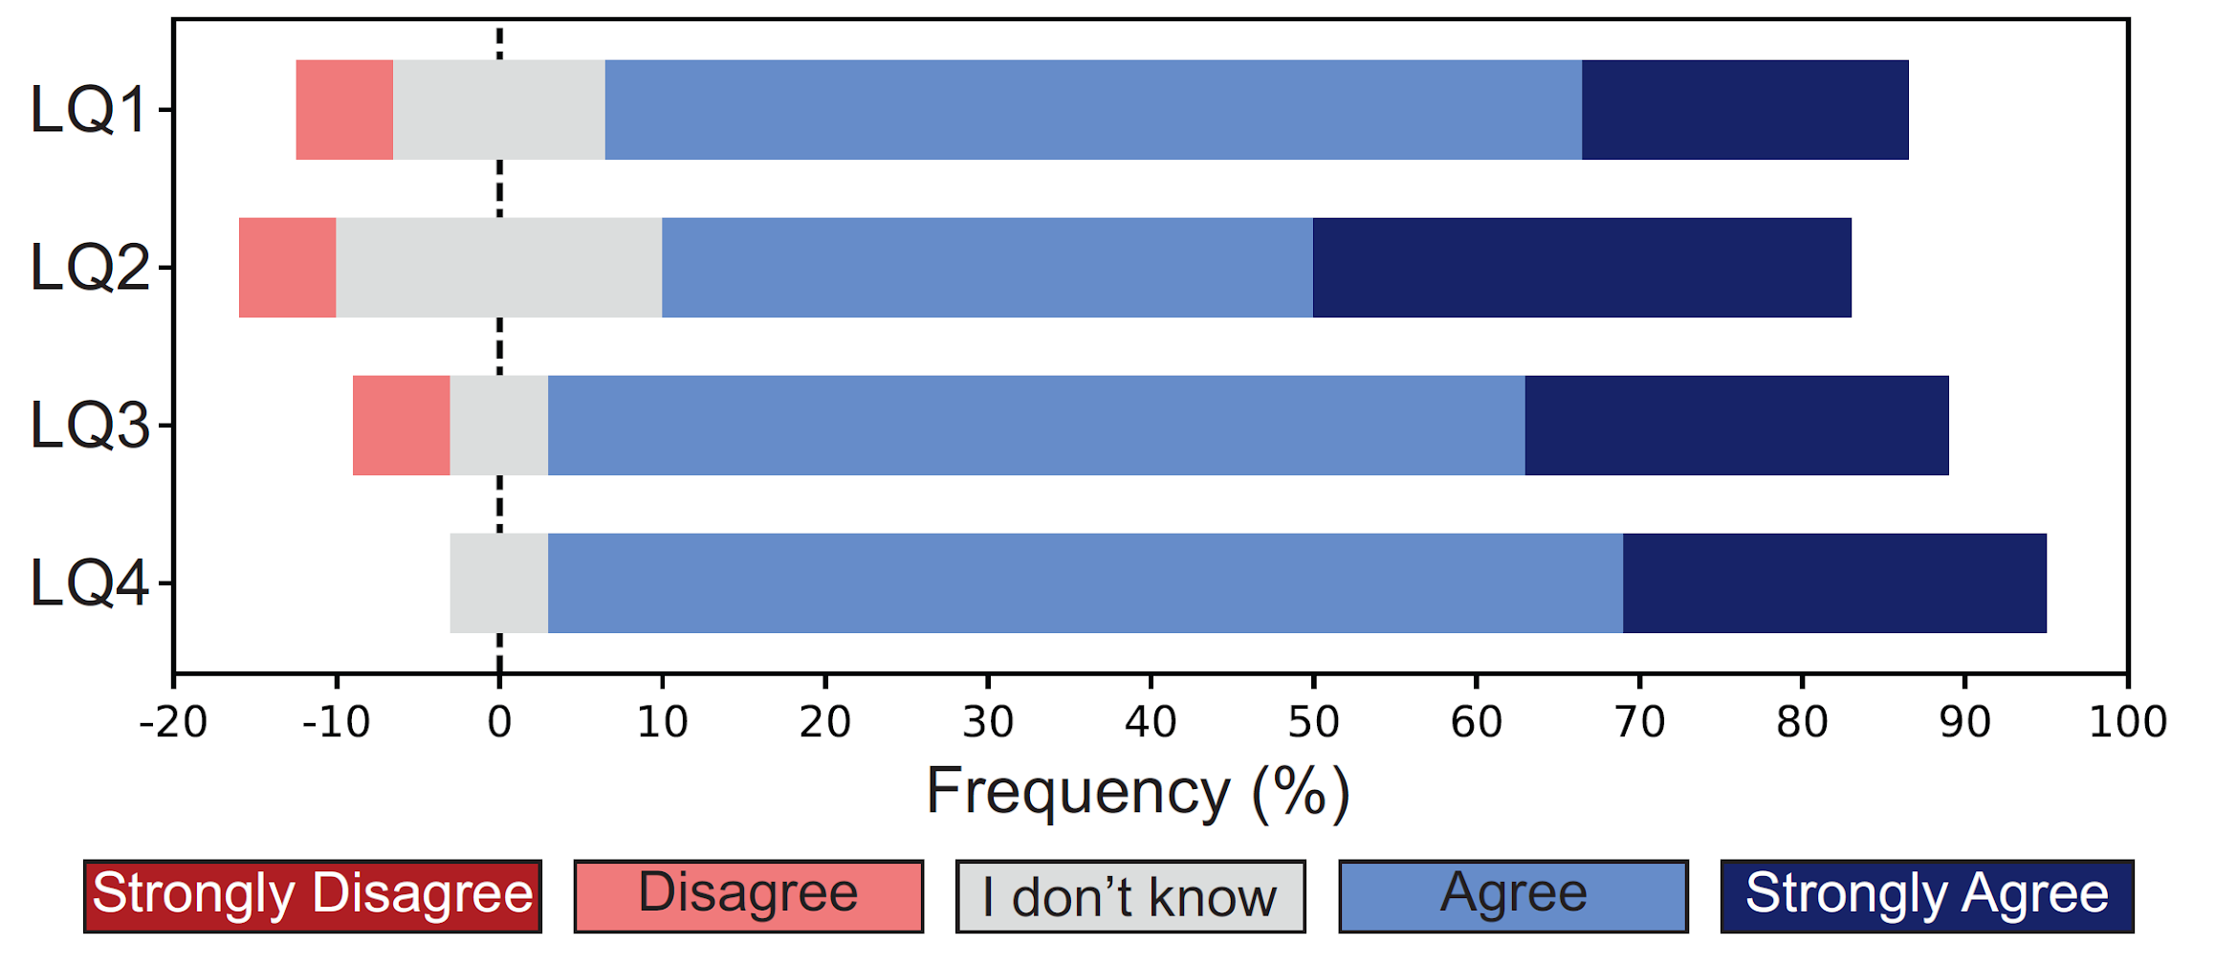
User Validation - Result
    Questions about user preferences and feedbacks
Intuitiveness and Usability
Efficiency to optimize their time
Ease to use
Easiness of system learning
Participants answer for the user preferences of the system

Slide 39

06.
Conclusion

Slide 40
Conclusion
EHR & visualization techniques: insightful and informative systems
ClinicalPath is an important tool for EHR.
  Track the clinical evolution of a patient.
  Reveal patient test information over time in a screen view.
  Match the real needs of medical practitioners by a group of 15 domain experts.
The visualization system is easy of learning, with a high level of usability, efficiency, and intuitiveness.

Slide 41
Future work
Integrate ClinicalPath with other systems
Include ImageData such as X-ray, Resonance, Tomography
Improve Visualization and Interaction features
Adapt to Population-based Tool

Slide 42

Thank You For Your Attention

Slide 43
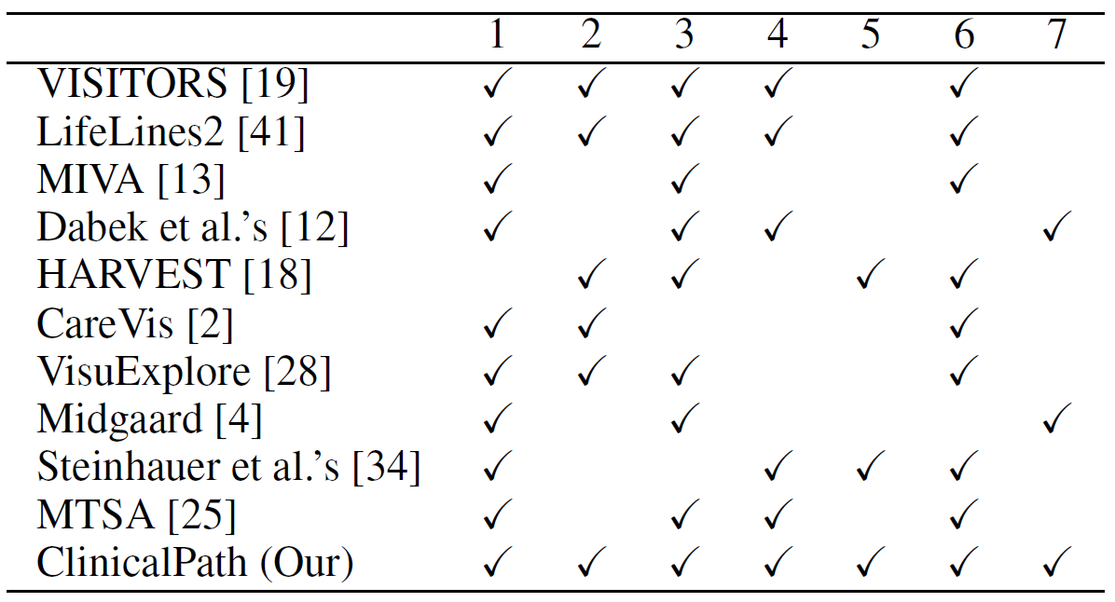
Related Work
Comparison of EHR systems according to seven different aspects
Selecting
Grouping
Filtering
Test result classification
Clinical history and outcome
User evaluation
Scalability of tests over time
tests and
time intervals

Slide 44
Method – Requirements and Tasks
Requirements (S1-S6):
How the test results change over time?
What tests are performed on a specific day or period of time?
Compare tests’ results of a patient over time (patient history)?
Which departments of the facility is/was the patient located in?
If and What part of the patient’s event history is available?
Analyze tests results according to target specialties, such as endocrine, cardio, renal ones.
Tasks (T1-T6):
Exhibit and classify test results (how - S1, S3)
Select tests and results according to date (how – S2)
Filter only dates with tests performed (how – S2, S3)
Compare a set of test results over time (why – S3)
Map clinical history and outcomes (what- S4, S5)
Group and order tests (how – S3, S6)
Category | Type of question | Example
Higher-level goals | why | discover, search, & comparison
Lower-level goals | how | filter, arrange, navigate
User-specific tasks | what | inputs and outputs

Slide 45
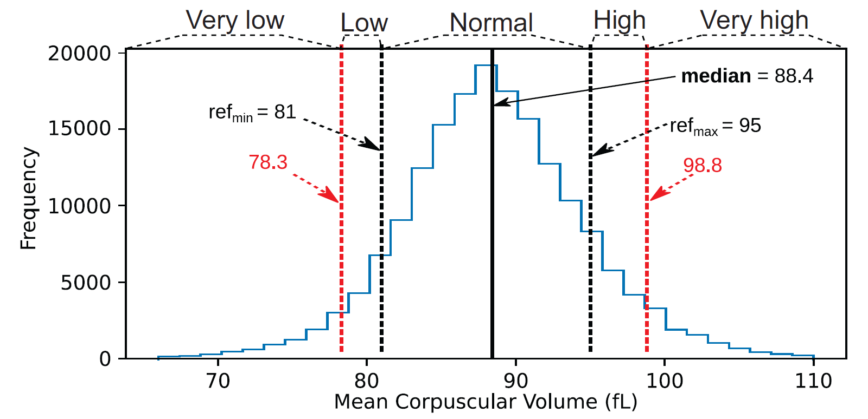
ClinicalPath - Data preprocessing
Data Cleaning and Normalization
Test Results Categorization
Example of the calculation of the five categories using the reference values, and the medians in low/high subsets

Slide 46
ClinicalPath - Implementation
ClinicalPath is freely available system developed in Java to support multiple platforms.
  JGraphX: the geometric shapes with interaction.
  JFreeChart: the interactive line chart.
  ClinicalPath requires the data represented in a graph format
    The source nodes are the patients
    The target nodes are tests
    The edges are the test results in each timestamp.

